Slide 1
NFA to DFA
Lecture 3

Slide 2
Topics
Distinguish between an NFA and a DFA
Transform an NFA to DFA

Slide 3
NFA vs DFA
  For any input symbol, nondeterministic one can transit to more than one states.
  Epsilon transition

Slide 4
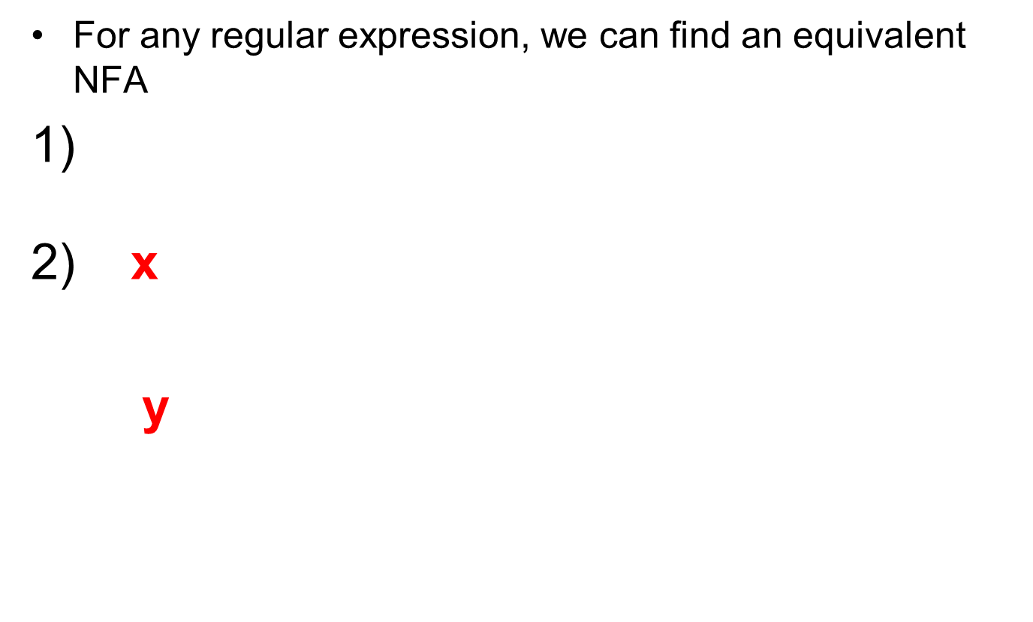

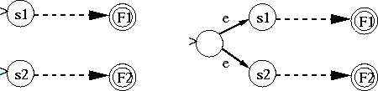
NFAs & Regular Expressions
X U Y

Slide 5
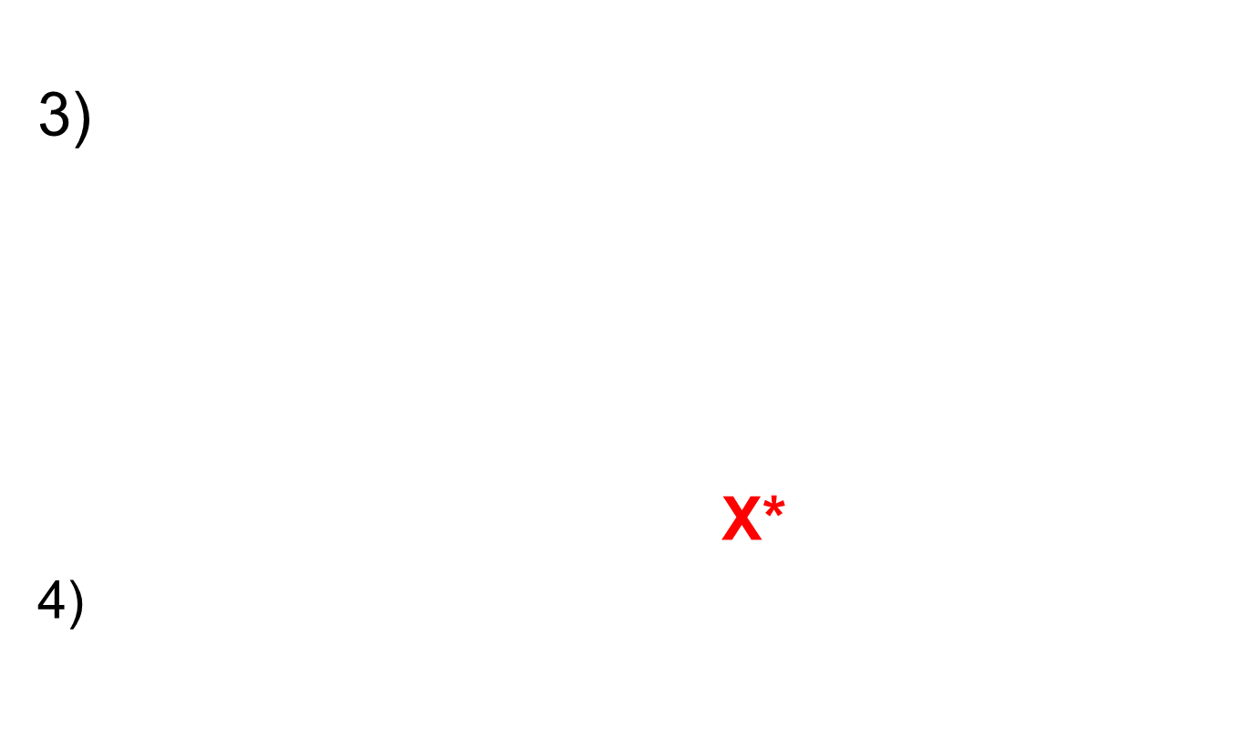
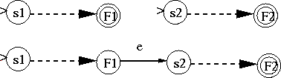

NFAs & Regular Expressions
X
Y
XY
X

Slide 6
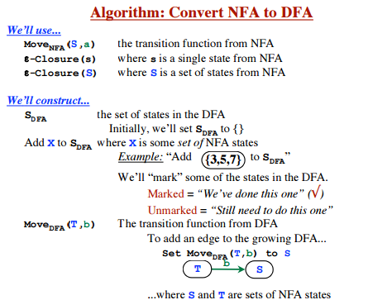

Construct DFA from NFA
‹#›

Slide 7
What differs DFA from NFA
DFA is a special case of NFA where there are no empty moves to change the state.
‹#›

Slide 8
NFA TO DFA conversion
(a/b)* abb
E-Closure(s)
  S denotes
  Set of NFA states reachable from NFA states s on ∑ transitions alone.
  Where ∑ -empty string
‹#›

Slide 9
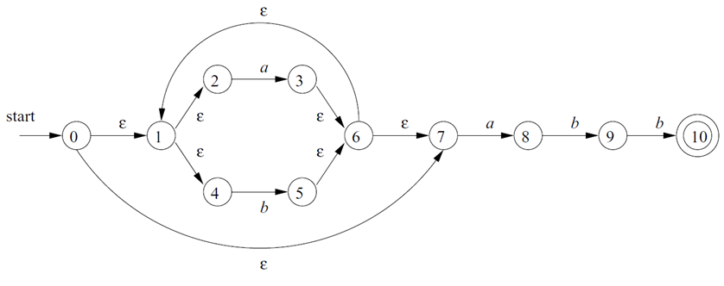
NFA-DFA
Step 1:
Mark the states that have ∑ transitions.
E-closure(0)={0,1,2,4,7} ->Name the state as A
‹#›

Slide 10
NFA –DFA
Step 2 :
Set A of DFA now contains
A={0,1,2,4,7}
Possible Inputs are a/b
{3,6,1,4,2,7,8}
{1,2,4,5,6,7}
a
A
B
b
C
‹#›

Slide 11
NFA –DFA
Step 3
{1,2,3,4,6,7,8}
{1,2,3,4,6,7,8}
{1,2,4,5,6,7,9}
a
B
B
b
D
‹#›

Slide 12
NFA –DFA
Step 4
{1,2,4,5,6,7}
{1,2,3,4,6,7,8}
{1,2,4,5,6,7}
a
C
b
b
c
‹#›

Slide 13
NFA –DFA
Step 5
{1,2,4,5,6,7,9}
a {1,2,3,4,6,7,8}
b {1,2,4,5,6,7,10}
B
D
E
‹#›

Slide 14
NFA –DFA
Step 6
{1,2,4,5,6,7,10}
{1,2,3,4,6,7,8}
{1,2,4,5,6,7}
States in DFA are A,B,C,D,E
a
B
E
b
C
‹#›

Slide 15
NFA –DFA
states | transitions
A | {1,2,3,4,7}
B | {1,2,3,4,6,7,8}
C | {1,2,4,5,6,7}
D | {1,2,4,5,6,7,9}
E | {1,2,4,5,6,7,10}
a | b
B | C
B | D
B | C
B | E
B | C
‹#›

Slide 16
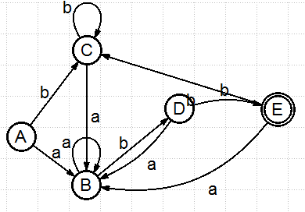
DFA
Final Step
Start
Accepting State
(a/b)* abb NFA->DFA
‹#›

Slide 17
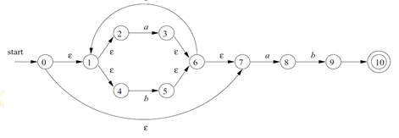
Try This
Convert the given NFA to DFA.
a
‹#›

Slide 18
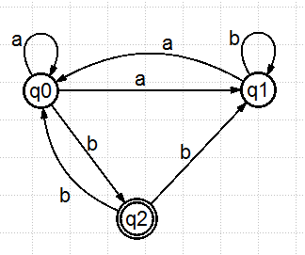
Example-2
Conversion of NFA without ε to DFA
‹#›

Slide 19

State Transition Table
Step 1
 | a | b
q0 | {q0,q1} | q2
q1 | q0 | q1
q2 |  | q0,q1
New States {q0,q1} - q3
Note:State q1 is not required ,since it is already present in {q0,q1}
‹#›

Slide 20
State Transition Table
Step 2:
New State { q1,q2} - q4
 | a | b
q0 | {q0,q1} | q2
q2 |  | q0,q1
{q0,q1} | {q0,q1} | {q1,q2}
‹#›

Slide 21

State Transition Table
Step 3:
 | a | b
q0 | q3 | q2
q2 |  | q3
{q0,q1}q3 | q3 | q4
{q1,q2}q4 | {q0} | q3
‹#›

Slide 22
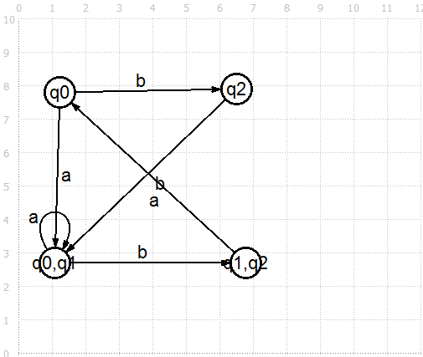
DFA
b
‹#›

Slide 23
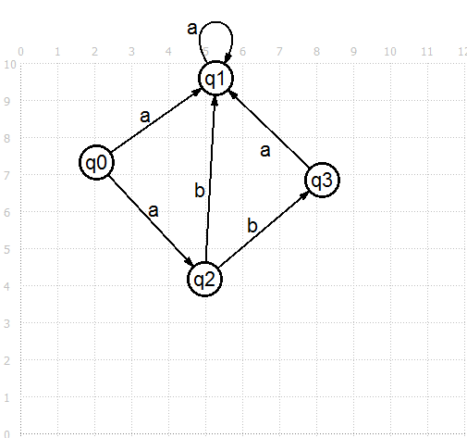
Example 3-NFA to DFA
a
a
‹#›

Slide 24
State Transition Table
 | a | b
q0 | {q1,q2}
q1 | {q1,q2}
q2 |  | {q1,q3}
q3 | {q1,q2}
New States : {q1,q2}
{q1,q3}
‹#›

Slide 25
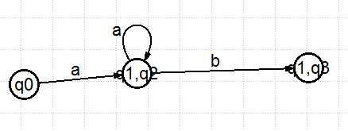
State Transition Table
 | a | b
q0 | {q1,q2}
{q1,q2} | {q1,q2} | {q1,q3}
{q1,q3} | {q1,q2}
a
‹#›

